Slide 1


Automatic Fire: The Creation of the Doom Slayer’s Shoulder Cannon
By:
Alyssa Jackson

Slide 2
Structure Rundown
Background Introduction (What the Heck, Alyssa)
Building the War Machine
01
02
03
Results/Live Demonstration
04
Progress Past the Project
05
Conclusion
What is it Meant to Do?
Physical Creation
Parts, Layout, Models, and Diagram
The Software Side
Coding the War Machine
Face Detection Using Haar Cascades

Slide 3

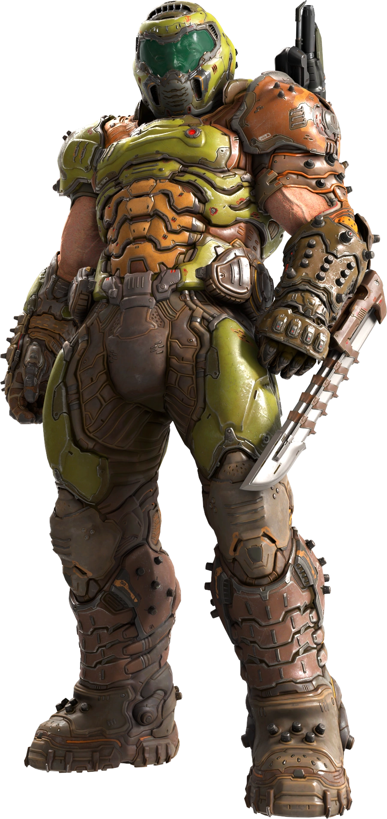
Background Introduction (What the Heck, Alyssa)
The shoulder turret cannon comes from the Doom Eternal game
Called the Equipment Launcher; used by the Doom Slayer (i.e. you, the main character)
Shoots grenades, fire (like a flamethrower), and ice bombs
This is not my first time/attempt in building this project
Work began after taking computer vision with Professor Bestie
Intended to make this for a halloween costume

Slide 4
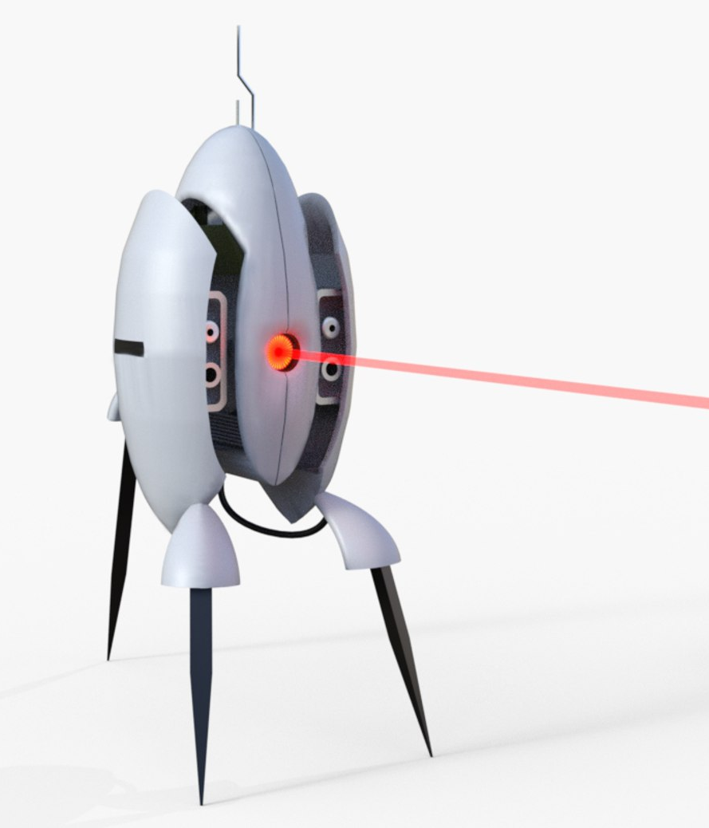
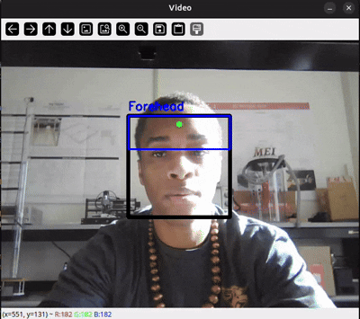
What is it Meant to Do?
The physical “turret” should detect any tracked faces from the camera and point a laser at them
The laser should ideally only point the last detected face in the camera
Minimize errors (false positives, false negatives, etc.) and point the laser “in between the eyes” (center of the forehead)
The turret should be able to take face information and use it to track and point at the face
Must be fast enough to be real time, and reliable enough to always point towards the head

Slide 5
Building the
War Machine

Slide 6
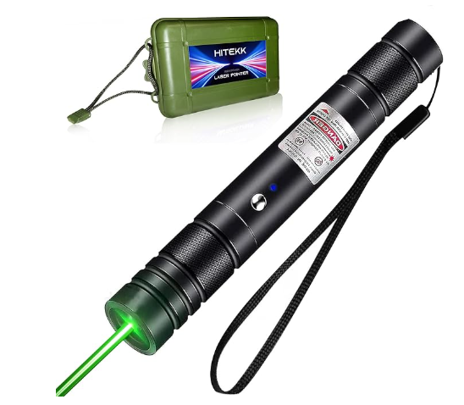
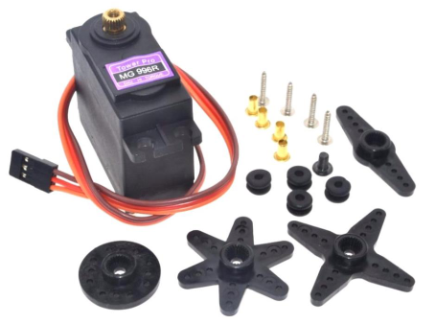
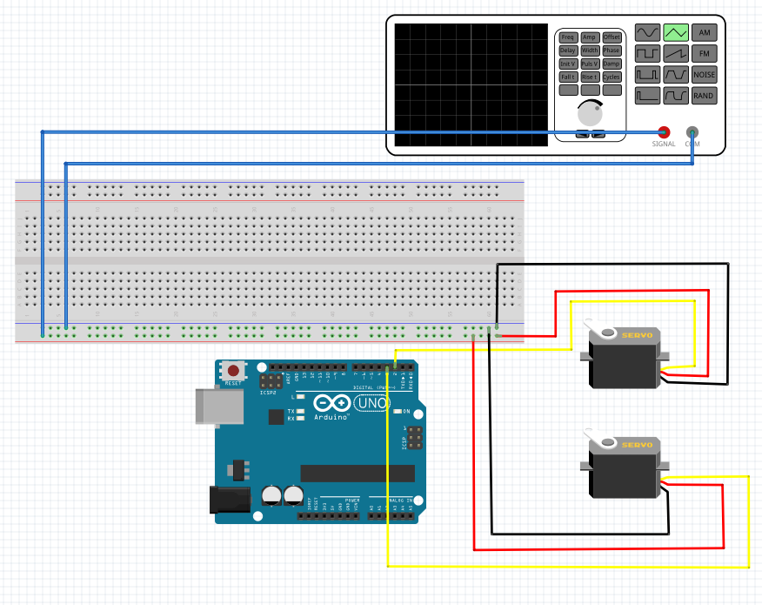
Parts and Layout of the Turret
The turret consists of:
Laser pointer
HITEKK Green Laser Pointer
2 Servo motors
MG996R servos
One controls the x-axis and y-axis
2 Machine Screws and Nuts
Stands
3d printed stands for the servo motors
2 Additional Spaces were also needed
Power supply
Computer
My laptop
Main Brains of the face detection
Camera
Webcam of the laptop
Arduino
The brains that move the servos with the information gathered from the computer
Breadboard
Not a board made of bread unfortunately…
Wires
Obviously

Slide 7
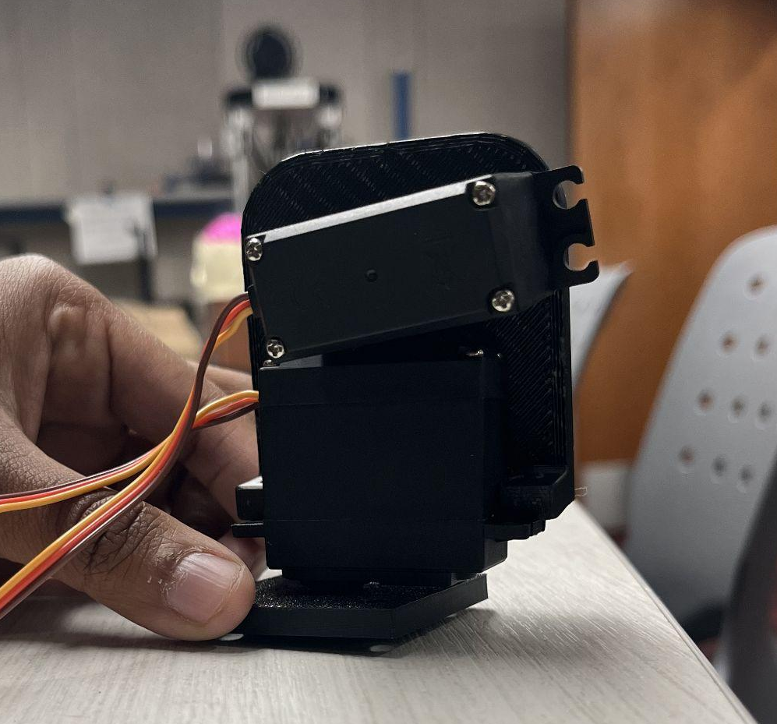
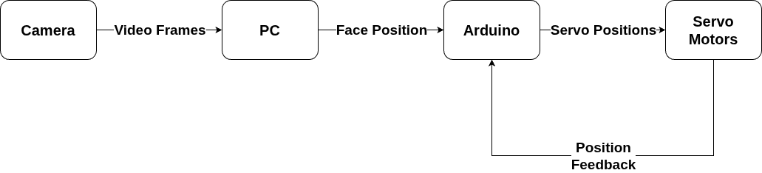
Model and Diagram of the Turret

Slide 8
Coding the War Machine
The python script (laptop/pc side) uses openCV to open the webcam and stream the video to be analyzed and altered
Each frame is treated like an individual image and processed
Converted to grayscale and “scanned” for faces
Once a face (or faces) is detected, then the approximate location of the forehead is calculated and sent to the Arduino
If multiple faces are detected at once, then the last face detected will be the target
Using the coordinates, the Arduino then moves the servo motors to the point the laser at the target
Basically How the Brains Work

Slide 9
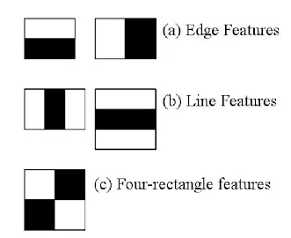
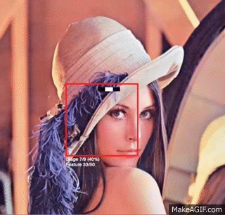
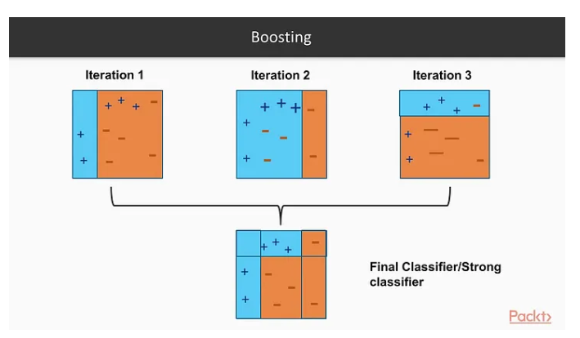
How the Face Detection Works - Haar Cascades
Haar Cascades are a machine learning algorithm for object detection
Created by Paul Viola and Michael Jones, but concept introduced by Alfred Haar
Used in real-time object detection and can only identify WHAT an object is, not WHO it is
The idea behind it is to create Haar Features that are common within the object, using integral images, and use Adaboost Training
Not every feature is important and most get ignored
For the important features, now classifiers, they take the weak classifiers and combine them into strong classifiers
Strong classifiers are found and identified through cascading classifiers
The algorithm is so fast because most of the features get ignored
The gif shows the entire process from start to finish

Slide 10
Results/Live Demonstration

Slide 11
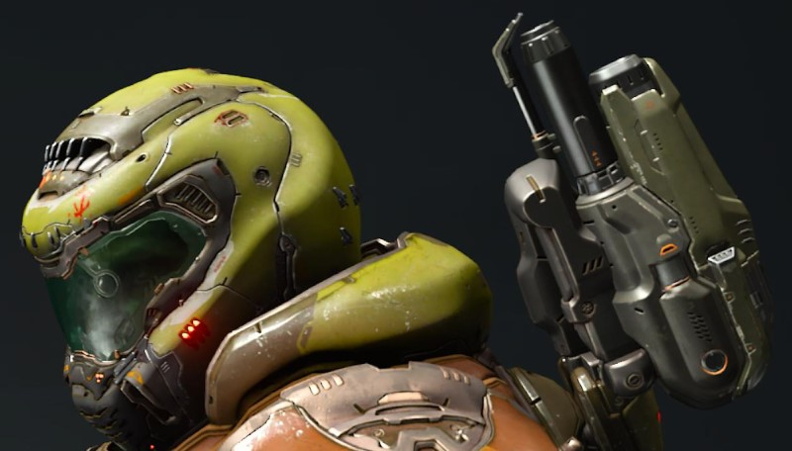
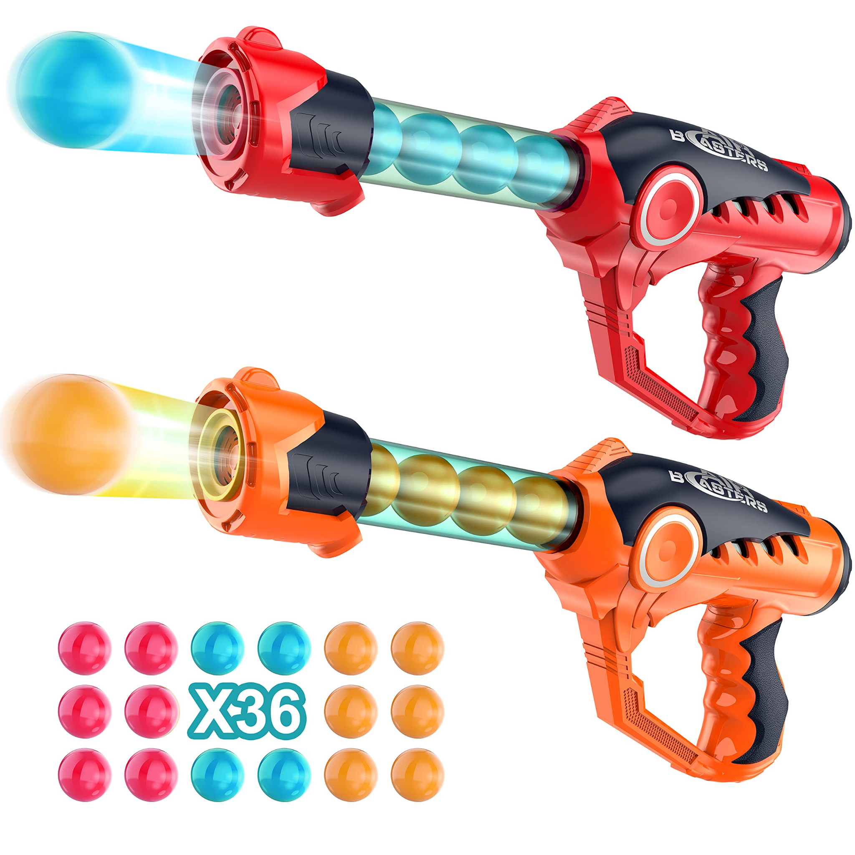
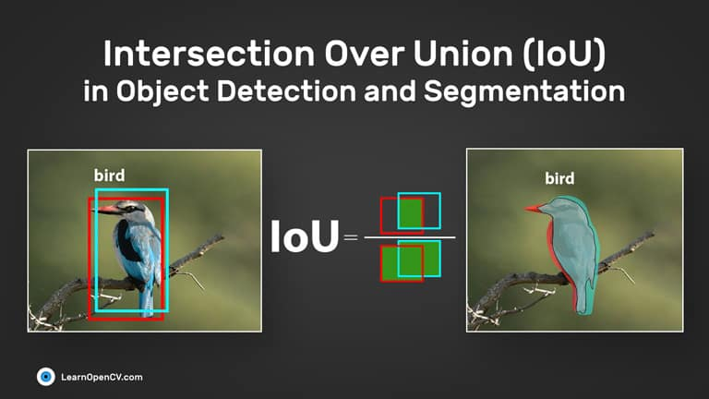
Progress Past the Project
Restart on the costume
3d model the equipment launcher body for the servos
Step 1. Learn 3d modeling
Get a raspberry pi (or something similar), look into mini cameras and portable power sources
Maybe make a PCB for it…
Implement a button-activated ball launcher
More mechanical than electrical, but could be fun (have fun sound effects, lights, etc.)
Play around with the Parameters of the Haar Cascade face detection
Look into reintroducing the Intersection of Union (IoU)
Area of Intersection/Area of Union
Basically combining the frontal and profile haar cascade models for higher tracking accuracy
More computationally taxing and more power required
Look into Face Recognition
Requires a dataset of multiple pictures of one person and a LLM
More computationally taxing and more power required

Slide 12
Conclusion
I’m a Genius
Obviously
Object detection is a very powerful tool that can be used to implement security measures
Do something when a person/animal/object is detected
This project can have seemingly endless ways of working, personality, and customization
Math is truly in every aspect of computer science
And in engineering as well…
3d Modeling is hard

Slide 13
Thank You!
Any Questions?

